Slide 1

Department of Computer Engineering
(01CE1702 – Artificial Intelligence)
(Unit : 1)
Introduction to Artificial Intelligence

Slide 2
Unit-1 Introduction to AI
Outlines:
Introduction to AI.
The AI Problems.
AI techniques.
Task Domains of AI.
Level of AI Model.
Criteria of Success.
Applications of AI.

Slide 3
Unit-1 Introduction to AI
Outlines:
Introduction to AI.
The AI Problems.
AI techniques.
Task Domains of AI.
Level of AI Model.
Criteria of Success.
Applications of AI.

Slide 4
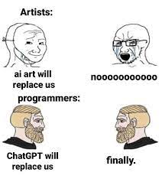
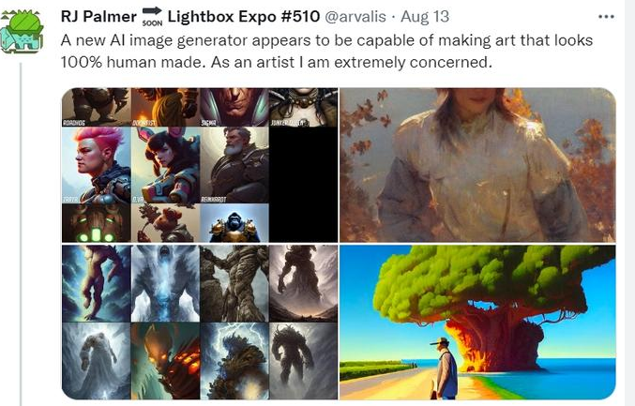
Some memes

Slide 5
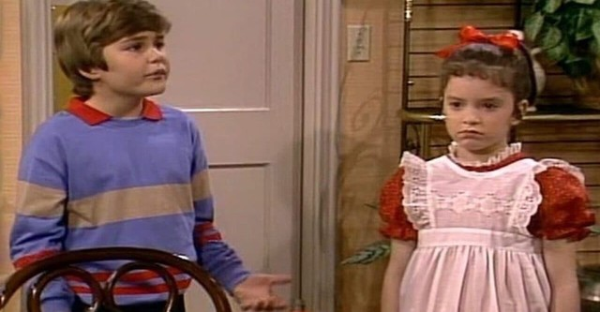

Reality check
Series Name is Small Wonder
First episode date ( 7th September 1985)
Final episode date (20th May 1989)
4 series in 4 years

Slide 6
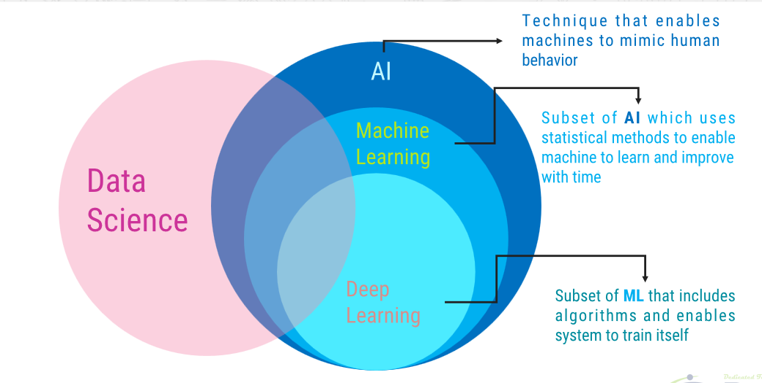
Some Buzzwords

Slide 7
Some questions
What is intelligence?
What is Artificial Intelligence?

Slide 8
Intelligence
Intelligence has been defined in many ways: the ability/capacity for
Logic,
Communicate,
Understanding,
Self-awareness,
Learning,
Emotional-knowledge,
Reasoning,
Planning,
Creativity,
Critical thinking,
and problem-solving.

Slide 9
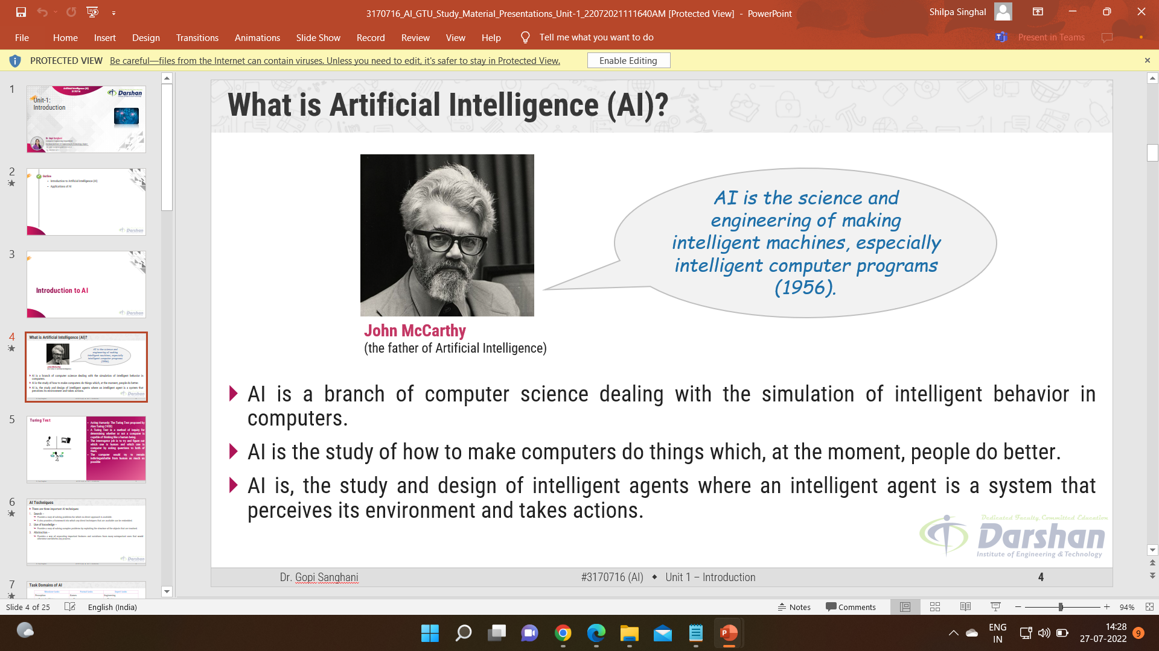
What is Artificial Intelligence?(AI)

Slide 10
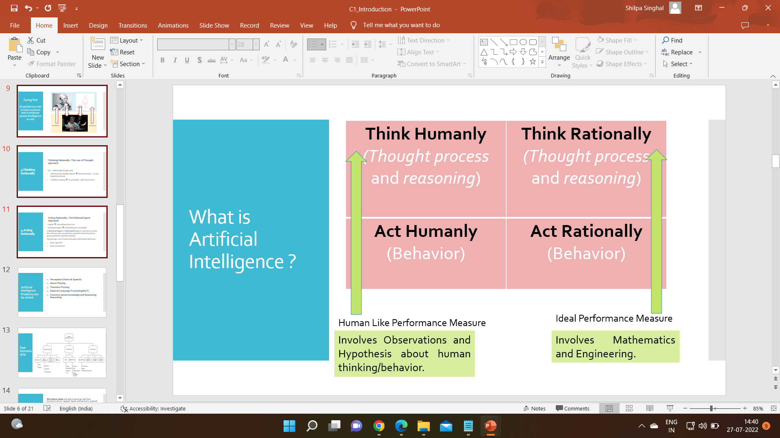
What is Artificial Intelligence ?

Slide 11
1.Thinking Humanly
Thinking Humanly : The Cognitive Modeling Approach
Introspection
Psychological experiment
Brain imaging
Cognitive Science Field = Computer Model from AI + Experimental techniques from psychology = Output (Testable theories of human mind)

Slide 12
2.Acting Humanly
Acting Humanly : The Turing Test approach
Turing test
NLP
Knowledge representation
Automated reasoning
Machine learning
Total Turing Test
Computer Vision (to perceive objects)
Robotics (to manipulate objects and moves)

Slide 13
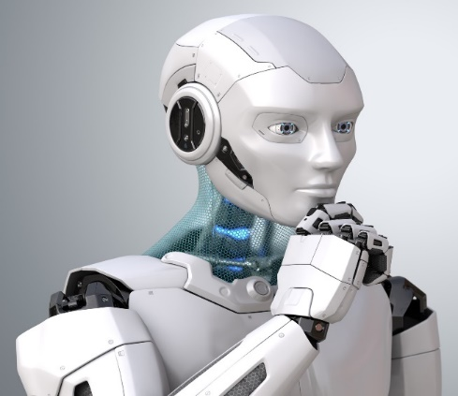


Turing Test (A satisfactory test to know a person and a computer posses Intelligence or not)
Turing Test
Answers
Answers
Questions
Questions

Slide 14
Turing Test Approach
Acting Humanly: The Turing Test proposed by Alan Turing (1950)
A Turing Test is a method of inquiry for determining whether or not a computer is capable of thinking like a human being.
The interrogator job is to try and figure out which one is human and which one is computer by asking questions to both of them.
The computer would try to remain indistinguishable from human as much as possible.

Slide 15
3.Thinking Rationally
Thinking Rationally : The Law of Thought approach
So – called logical approach.
Informal knowledge (input) → formal (output – as per logical notation).
Problem solving → “in principle” and “in practice”.

Slide 16
4.Acting Rationally
Acting Rationally : The Rational Agent Approach
Agent → something that acts.
Rational Agent → something act rationally.
A Rational Agent or Rational being is a person or entity that always aims to perform optimal actions based on given premises and information.
Advantages over human thought and human behavior:
More general.
More prominent.

Slide 17
The Artificial Intelligence Problems
Perception( Vision & Speech)
Game Playing
Theorem Proving
Natural Language Processing(NLP)
Common sense knowledge and Reasoning

Slide 18
AI Technique
An AI technique is a method that exploits knowledge that is represented so that:
The knowledge captures generalizations that share properties, are grouped together, rather than being allowed separate representation.
It can be understood by people who must provide it—even though for many programs bulk of the data comes automatically from readings.
In many AI domains, how the people understand the same people must supply the knowledge to a program.
It can be easily modified to correct errors and reflect changes in real conditions.
It can be widely used even if it is incomplete or inaccurate.
It can be used to help overcome its own sheer bulk by helping to narrow the range of possibilities that must be usually considered.

Slide 19
AI Techniques
There are three important AI techniques:
1.Search –
Provides a way of solving problems for which no direct approach is available.
It also provides a framework into which any direct techniques that are available can be embedded.
2.Use of knowledge –
Provides a way of solving complex problems by exploiting the structure of the objects that are involved.
3.Abstraction –
Provides a way of separating important features and variations from many unimportant ones that would otherwise overwhelm any process.

Slide 20
Tasks Domain of AI
Mundane tasks are the ones that we( the humans) do on regular basis without any special training
Formal tasks - are the ones where there is an application of formal logic, some learning etc.
Expert tasks- are the ones that needs expert knowledge without common sense, which can be easier to represent and handle such as engineering, fault finding, manufacturing planning, medical diagnosis etc.

Slide 21
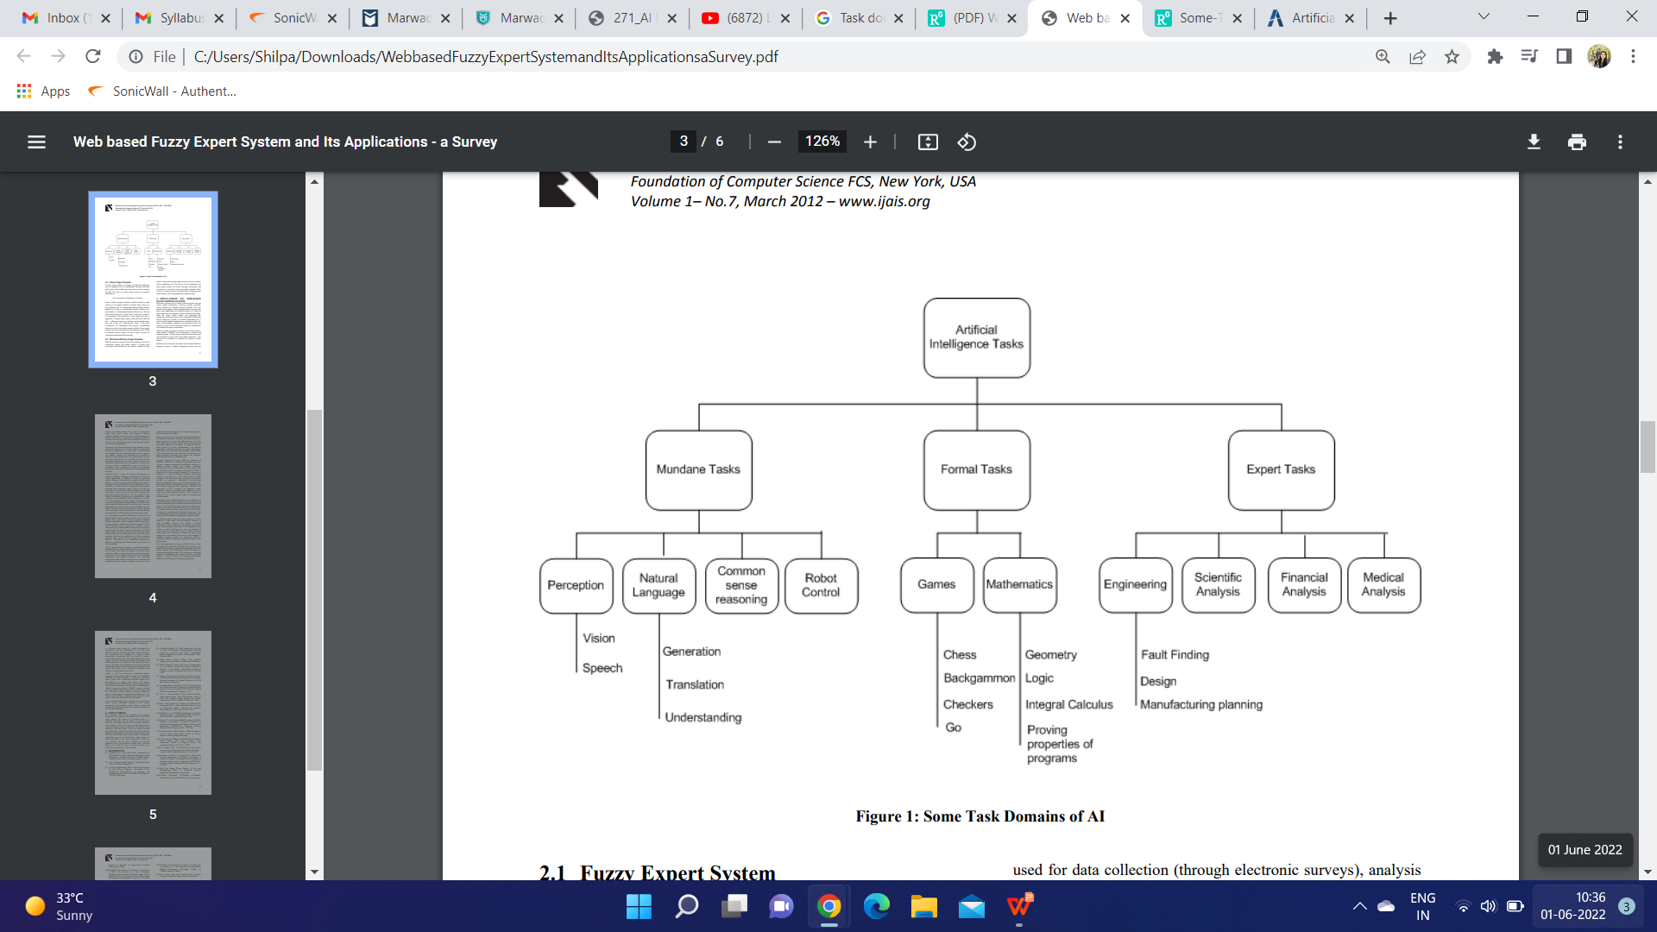
Tasks Domain of AI

Slide 22
AI Problems and Solution Techniques
The following questions are to be consideredand required to solved any AI problem:
1. What are the underlying assumptions about intelligence?
2. What kinds of techniques will be useful for solving AI problems?
3. At what level human intelligence can be modelled?
4. When will it be realized when an intelligent program has been built?

Slide 23
Types of AI
1. Weak AI | 2. Strong AI
Machines/programs are sensing for things similar to what they know, and classifying them accordingly. | It does not classify, but uses clustering and association to process data.
Example: If you ask Alexa to turn on the TV, the programming understands key words like On and TV. The algorithm will respond by turning on the TV, it is only responding to its programming. In other words, it does not focus on meaning of what you said. | Example: Featured in many movies, strong AI acts more like a brain.
Weak AI applications: Alexa Chess AlphaGo | Strong AI application: Robot. Suggestion for correction.

Slide 24
LEVEL OF THE AI MODEL
It signifies the importance what we are trying to achieve through AI
Is our goal trying to produce programs that do the intelligent things that people do ?
Or we want programs to do the task easiest way?
Efforts to perform the task same as human can be divided into two classes:
Programs in the first class attempt to solve problems that a computer can easily solve and do not usually use AI techniques. Solve the problem that do not fit our definition of AI task.
AI techniques usually include a search, as no direct method is available, the use of knowledge about the objects involved in the problem area and abstraction on which allows an element of pruning to occur, and to enable a solution to be found in real time; otherwise, the data could explode in size.
Examples of these trivial problems in the first class, which are now of interest only to psychologists are EPAM (Elementary Perceiver and Memorizer) which memorized garbage syllables.

Slide 25
The second class of problems attempts to solve problems that are non-trivial for a computer and use AI techniques. We wish to model human performance on these:
1. To test psychological theories of human performance. Ex. PARRY [Colby, 1975] – a program to simulate the conversational behavior of a paranoid person.
2. To enable computers to understand human reasoning – for example, programs that answer questions based upon newspaper articles indicating human behavior.
3. To enable people to understand computer reasoning. Some people are reluctant to accept computer results unless they understand the mechanisms involved in arriving at the results.
4. To exploit the knowledge gained by people who are best at gathering information. This persuaded the earlier workers to simulate human behavior in the SB part of AISB simulated behavior. Examples of this type of approach led to GPS (General Problem Solver).

Slide 26
Criteria for Success
How to Know if the machine has became Intelligence or not ?
It can be as tough as defining intelligence
Alan Turing proposed a test which later became famous by the name of turing test
It requires 2 person and machine all three in separate room
1 person interrogates machine and person without knowing who/what is inside room
Small Video to understand what exactly happens in Turing test
We may device more such standards in future which can help us to identify that if machine has been truly made intelligent or not.

Slide 27
Intelligent Agents in AI
What is Intelligent agent?,
Components of an AI system
(Intelligent Agent),
How Agents should Act?
Tasks Parameters for Agents to perform accurately,
Environment Parameters for
Agents to perform accurately.
Agent Types,
Simple reflex agents,
Reflex agents with state,
Goal-based agents,
Utility-based agents,
Learning agent.
Examples of Intelligent Agents in AI,
Xavier mail delivery robot,
Pathfinder Medical Diagnosis
System,
Alvinn,
Talespin,
Robot Soccer.

Slide 28
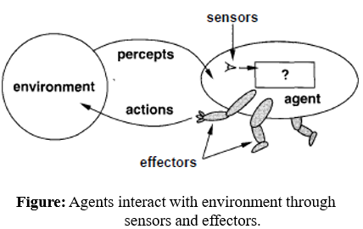
An agent is anything that;
-can be viewed as perceiving its environment.
-through sensors.
- and acting upon that environment through
effectors (actuators).
A human agent has
-eyes, ears, and other organs for sensors.
-hands, legs, mouth, and other body parts for effectors.
For example;
A robotic agent substitutes cameras and
infrared range finders for the sensors.
various motors for the effectors.

Slide 29
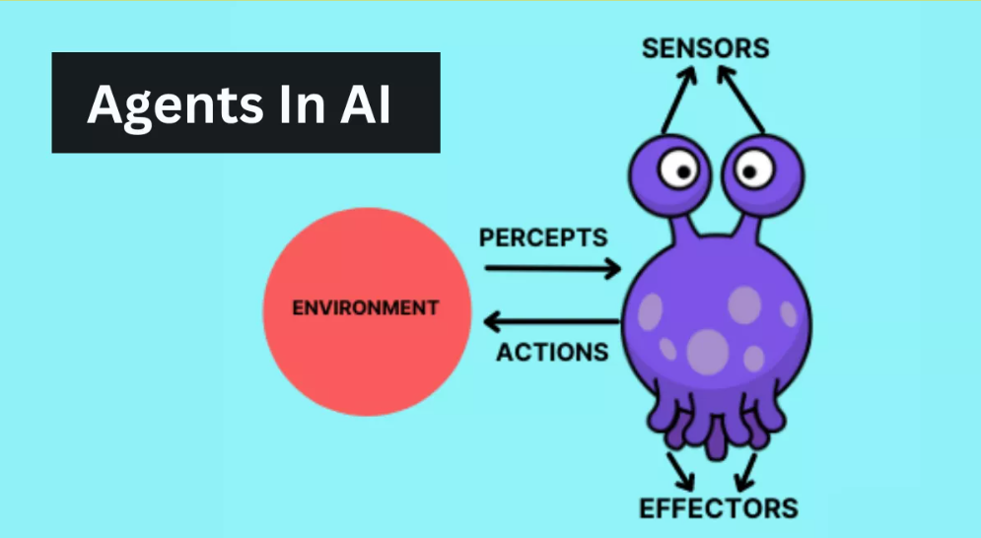
Intelligent Agents in AI
Artificial intelligence is the study of rational agents to make decisions related to a person, firm, machine or software.
Considering the past and present perceptual inputs of an agent at a particular instant, AI carries out a task with the best outcome possible.
AI system comprises of agent and its environment.
Fundamentally, an AI agent is a computer program capable of performing tasks autonomously by making decisions based on its environment, inputs, and predefined goals.

Slide 30
What is AI Agent?
Agents in AI are software programs that act autonomously to perform tasks or make decisions on behalf of users.
These intelligent agents can gather information, analyze data, and interact with their environment to achieve specific goals.
They are designed to mimic human behavior and are used in various applications such as virtual assistants, chatbots, and recommendation systems.

Slide 31
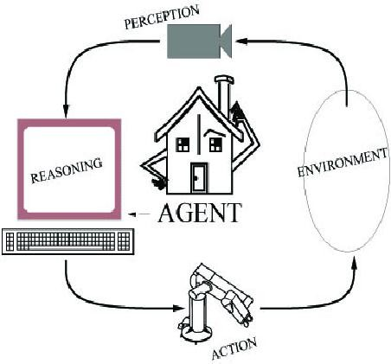
1.1. Components of an AI System (Intelligent Agent)
An agent perceives its environment through sensors and acts on the environment
through actuators.
Human: (sensors) are eyes, ears, actuators (effectors) are hands, legs, mouth.
Robot: (sensors) are cameras, sonar,
lasers, bumble-bee,
(effectors) are grippers, manipulators, motors.
Figure: Components of an AI system.
The agent’s behavior is described by its function that maps percept to action.

Slide 32
2. How Agents should Act?
An agents includes factor known as;
a rational agent that does the right thing. (what is this?)
Obviously, this is better than doing the wrong thing, but what does it mean?
As a first approximation, we will say that the right action is the one that will cause the agent to be most successful.
That leaves us with the problem of deciding “how” and “when” to evaluate the
agent's success.
Solution is;
- A fixed performance measure evaluates the sequence of observed action effects
on the environment.

Slide 33
2. How Agents should Act?
Example; Consider the case of an agent that is supposed to vacuum a dirty floor.
In case of “How” work with the evaluating performance measure.
- First, the performance measure would be the amount of dirt cleaned up in a single eight-hour shift.
Second, performance measure would factor in the amount of electricity consumed and the amount of noise generated as well.
Third, performance measure might give highest marks to an agent that not only cleans the floor quietly and also efficiently.
The “when” of evaluating performance measure is also important.
If we measured how much dirt the agent had cleaned up in the first hour of the day.
Either we query for appreciation or punishment to get positive results.

Slide 34
2. How Agents should Act?
(Cont…)
2.1:- Tasks Parameters for Agents to perform accurately:
Major factors to evaluate the agents actions are;
Use PEAS to describe task
Performance measure
Environment
Actuators
Sensors
Example: Taxi driver
Performance measure: safe, fast, comfortable (maximize profits).
Environment: roads, other traffic, pedestrians, customers.
Actuators: steering, accelerator, brake, signal, horn.
Sensors: cameras, sonar, speedometer, GPS, odometer, accelerometer, engine sensors.

Slide 35
2. How Agents should Act?
2.2:- Environment Parameters for Agents to perform accurately:
Fully observable vs. partially observable
Deterministic vs. stochastic / strategic
Episodic vs. sequential
Static vs. dynamic
Discrete vs. continuous
Single agent vs. multiagent
Fully observable vs. partially observable
monitoring the specific tasks (either Fully or partial).
agent's sensory apparatus gives it access to the complete/partial state of the environment, then we say that the environment is accessible (fully or partial) to that agent.
Example :
Chess is the fully observable scenario.
Taxi driving is the partially observable scenario.

Slide 36
2. How Agents should Act?
2.2:- Environment Parameters for Agents to perform accurately:
ii) Deterministic
- well-known knowledge of particular tasks. (either strategic or stochastic (change with condition)).
If the next state of the environment is completely determined by the current state then deterministic. (e.g., pick an object is acting as deterministic).
If the next state of the environment is previously knowledge-based determined by the current state then Strategic. (e.g., chess is acting as strategic).
If the next state of the environment is uncertain situation determined by the current state then Stochastic. (e.g., driving car is acting as stochastic).
iii) Episodic
- series of separate parts (either sequential or episodic).
the agent's experience is divided into "episodes." Each episode consists of the agent perceiving and then acting.
(e.g., delivering lecture is episodic, && playing chess is a sequential task).

Slide 37
2. How Agents should Act? (Cont…)
2.2:- Environment Parameters for Agents to perform accurately:
iv) Static vs dynamic
- knowledge about properties of process of a system. (either static or dynamic).
Static environments are easy to deal with because the agent need not keep looking at the
world. (e.g., Medical diagnosis is acting as static).
If the environment can change while an agent is deliberating (thinking), then we say the environment is dynamic. (e.g., driving a car is acting as dynamic).
If the environment does not change and agent's performance score does, then we say the environment is semidynamic. (e.g., chess is acting as semidynamic).
v) Discrete vs Continuous
- individually separate or without interruption (either discrete or continuous).
There are a fixed number of possible moves on each turn, then Discrete. (e.g., chess is acting as discrete). is acting as continuous).
vi) Agents
- events are performed by individual or group of users. (either single or multi).

Slide 38
3. Agent Types
Types of agents (increasing in generality and ability to handle complex environments).
Simple reflex agents.
Reflex agents with state.
Goal-based agents.
Utility-based agents.
Learning agent.

Slide 39
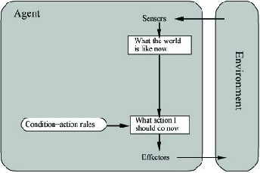
3. Agent Types (1. Simple Reflex Agent)
Simple reflex agents act only on;
the basis of the current percept, ignoring the rest of the percept history.
The agent function is based on the condition-action rule:
if condition then action.
This agent function only succeeds;
when the environment is fully observable.
SimpleReflexAgent(percept)
state rule
= InterpretInput(percept)
= RuleMatch(state, rules)
action = RuleAction(rule) Return action
Figure: Schematic diagram of a simple reflex agent.

Slide 40
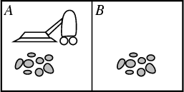
3. Agent Types (1. Simple Reflex Agent)
(Cont…)
Performance?
1 point for each square cleaned in time T?
#clean squares per time step - #moves per time step?
Environment: vacuum, dirt, multiple areas defined by square regions.
Actions: left, right, suck, idle.
Sensors: location and contents.
RuleMatch[A, dirty] then RuleAction[suck]
Class Test: Another example:-
- if car-in-front-is-speed_breaker
then initiate-braking

Slide 41
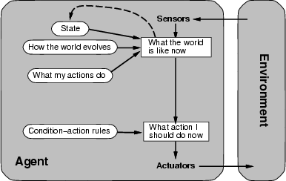

3. Agent Types (2. Reflex Agent With State)
Store previously-observed information.
Can reason about unobserved aspects of current state
ReflexAgentWithState(percept)
state rule
= UpdateDate(state,action,percept)
= RuleMatch(state, rules)
action = RuleAction(rule)
Return action
Example: Reflex Vacuum Agent
Figure: A reflex agent with internal state.
If status=Dirty then return Suck else if location=A then return Right else if location=B then right Left

Slide 42
3. Agent Types (3. Goal-based Agents)
Knowing about the current state of the environment;
- is not always enough to decide what to do.
For example: at a road junction, the taxi can turn left, right, or go
straight on.
The right decision depends on where the taxi is trying to get to.
In other words, the agent needs some sort of goal information.
- describes situations that are desirable.
here, decider need search and planning issues.

Slide 43
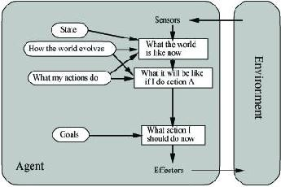
3. Agent Types (3. Goal-based Agents)
(Cont…)
Goal reflects desires of agents.
May project actions to see if
consistent with goals.
Takes time, world may change during reasoning.
Figure: An agent with explicit goals.

Slide 44
3. Agent Types (4. Utility-based Agents)
Goals alone are not really enough to generate high-quality behavior.
For example, there are many action sequences that will get the taxi to
its destination, thereby achieving goal.
but he must quicker, safer, more reliable, or cheaper than others.
Goals just provide a crude distinction between "happy" and "unhappy" states.
How utility function make the agents “happy”.
- if one world state is preferred to another, then it has higher utility for the agent.

Slide 45
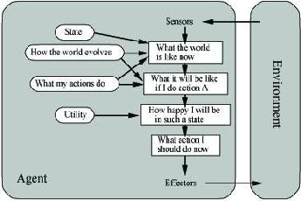
3. Agent Types (4. Utility-based Agents)
Utility is therefore a function that maps a state onto a real number;
describes the associated degree of happiness.
Two kind of cases in Utility;
First, when there are conflicting goals.
(for example; speed or safety).
the utility function specifies the appropriate trade-off.
Second, when there are several goals that the agent can aim for, none of which can be achieved with certainty.
- utility function provides a way in which the likelihood of success can be weighed up against the importance of the goals.
Figure: A complete utility-based agent.

Slide 46
3. Agent Types (4. Utility-based Agents)
(Cont…)
Evaluation function to measure utility f(state) -> value.
Useful for evaluating competing goals.

Slide 47
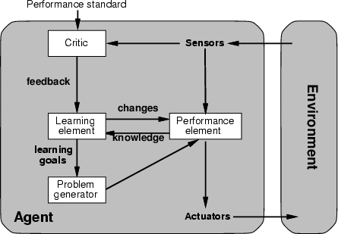
3. Agent Types (5. Learning Agents)
(Cont…)
Learning agent aim to learn new actions as it goes about its business, education, commercial industries.
Example, several people make news houses, so learned-based system having general training provides effective results in short- time.
This still requires some initial knowledge but cuts down on the programming greatly.
Figure: procedure for learning-based agent.

Slide 48
Pathfinder Medical Diagnosis System
Performance: Correct Hematopathology diagnosis.
Environment: Automate human diagnosis, partially observable.
Actuators: Output diagnostic kids and further test suggestions.
Sensors: Input symptoms and test results.

Slide 49
Application Domains of AI

Slide 50
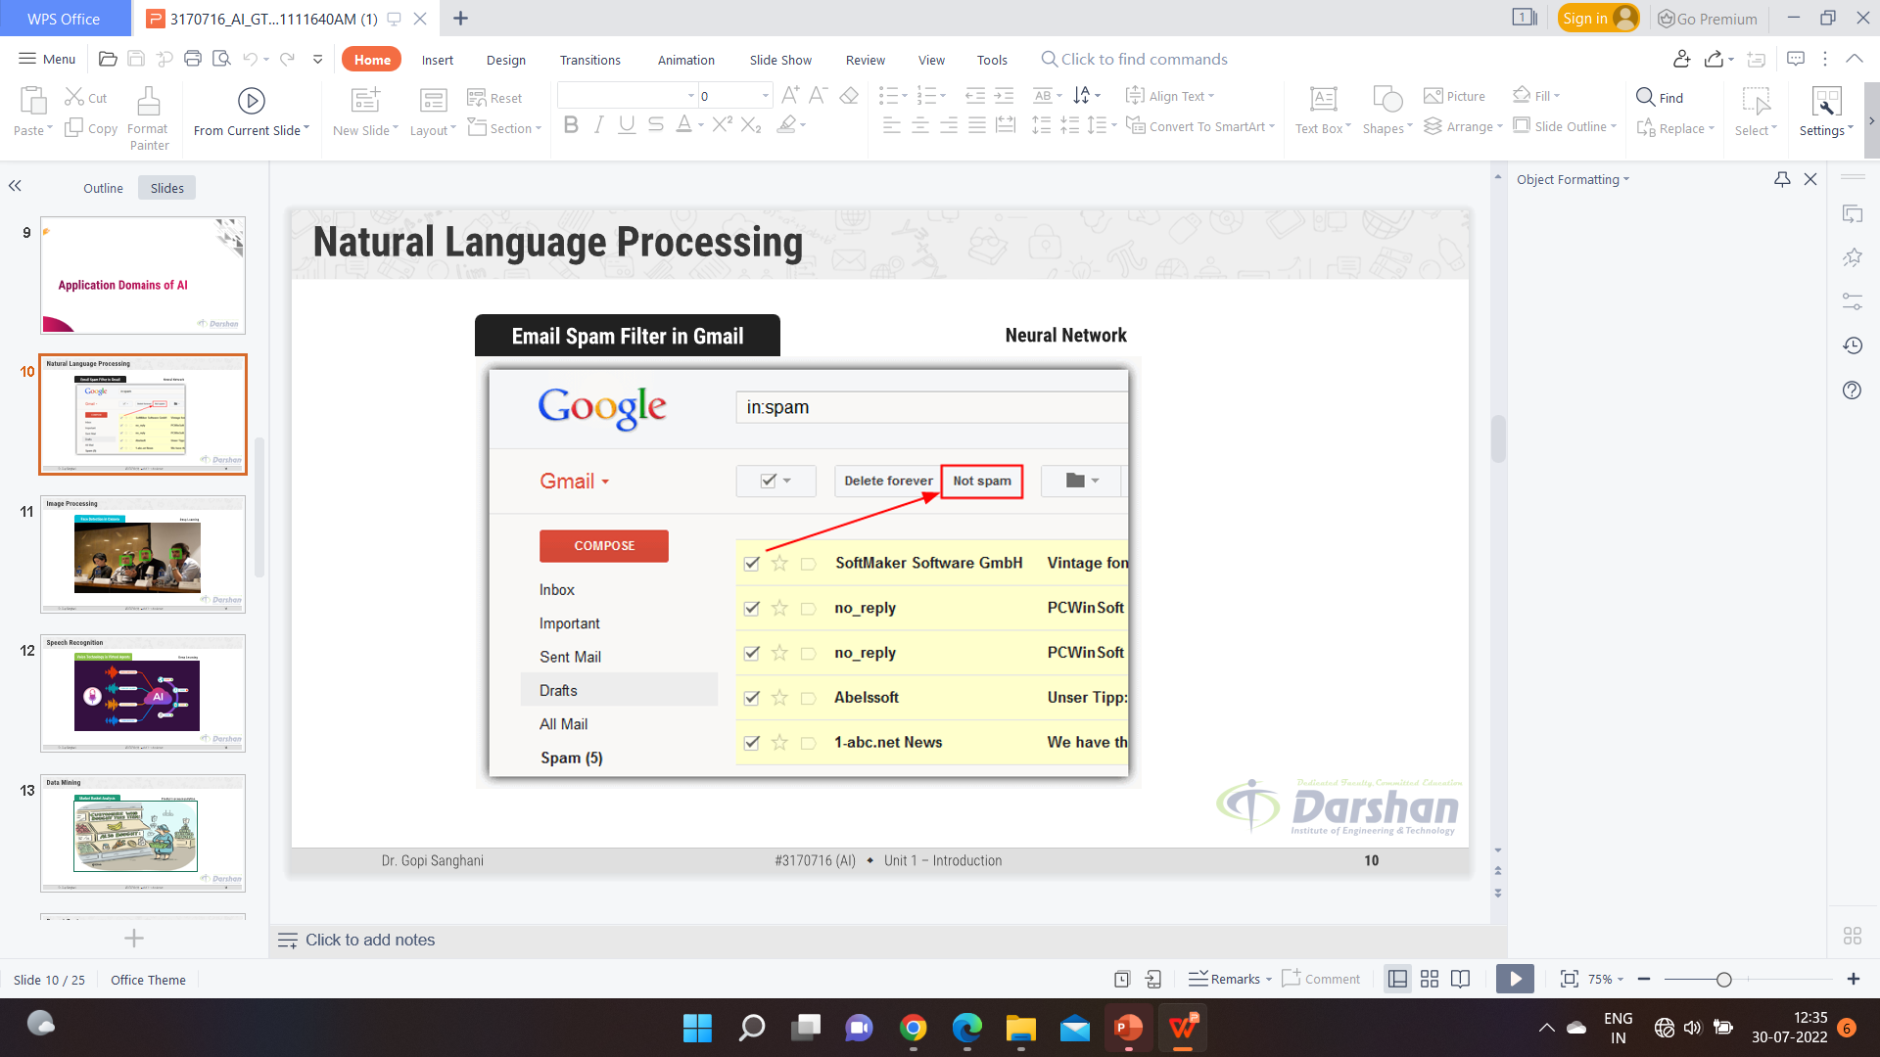
Natural Language Processing

Slide 51
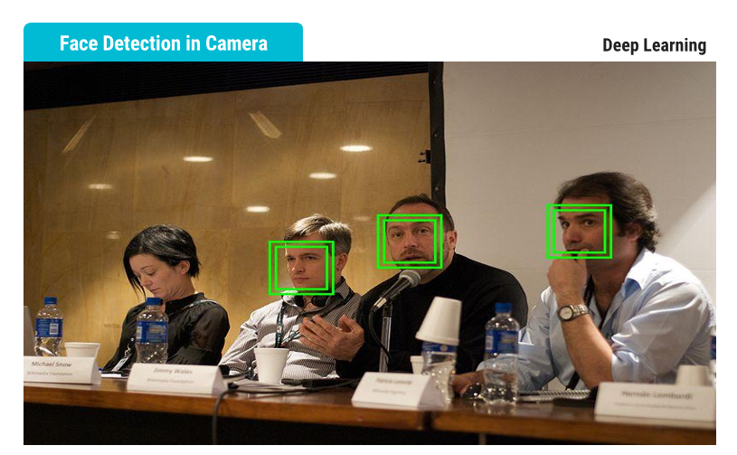
Image Processing

Slide 52
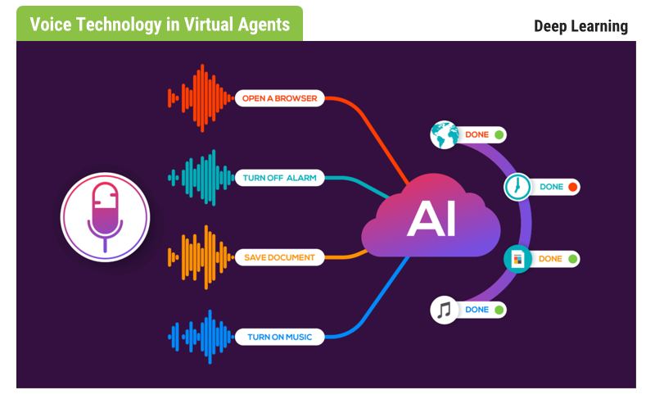
Speech Recognition

Slide 53
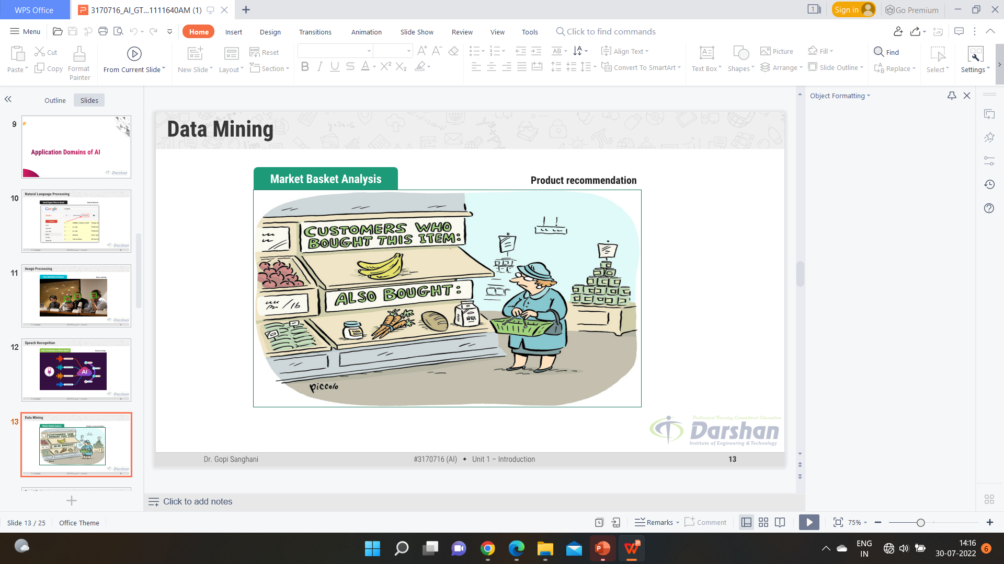
Data Mining

Slide 54
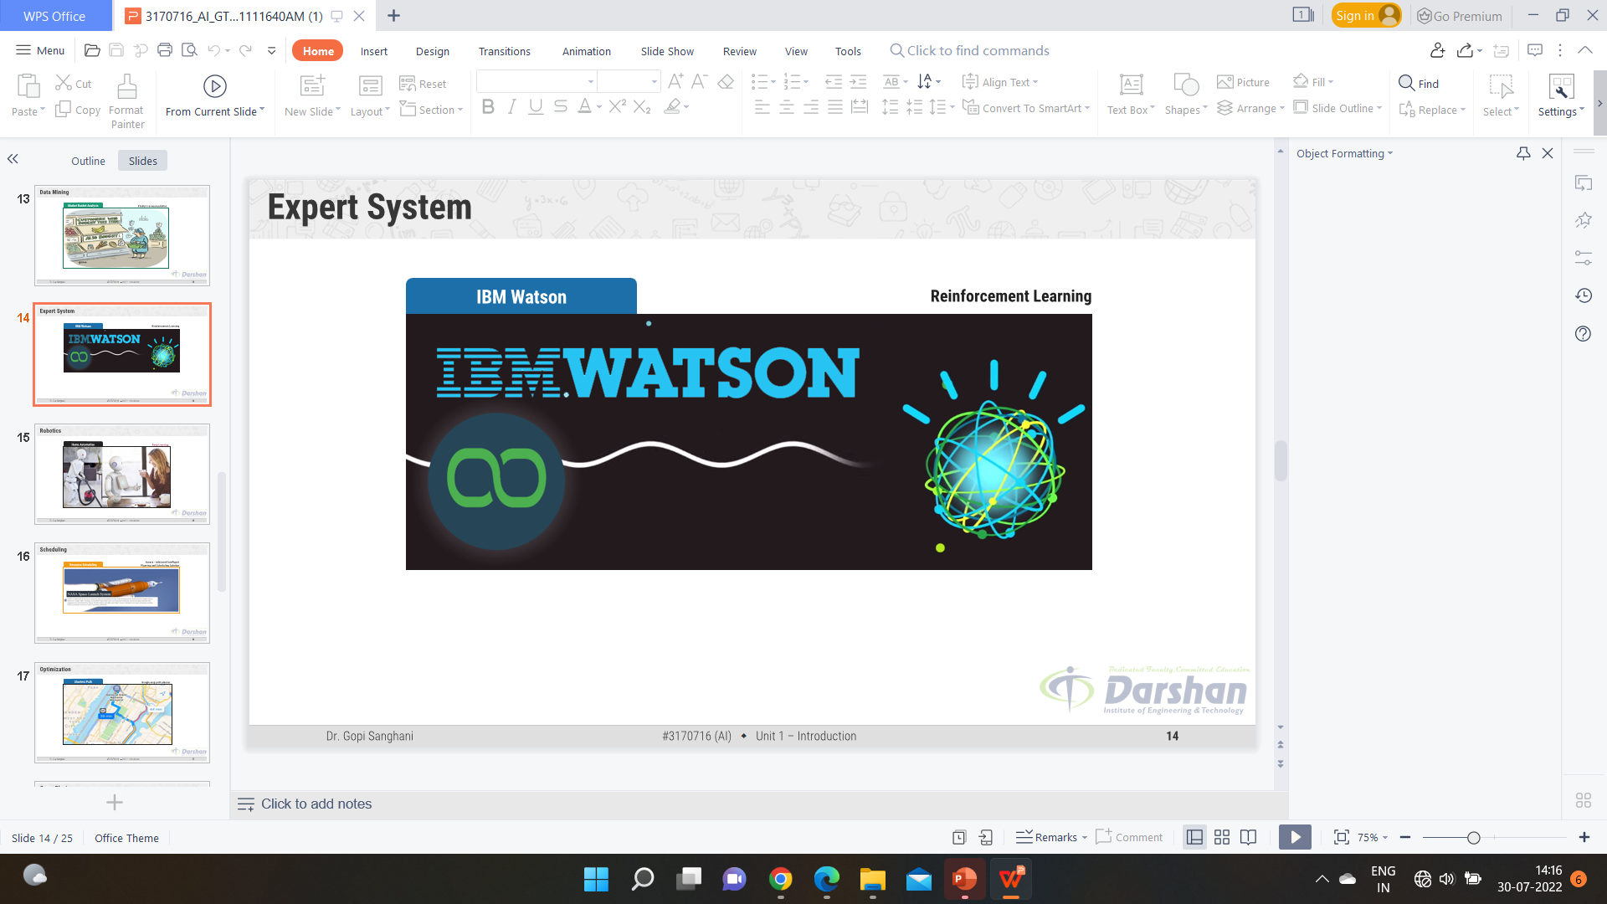
Expert System

Slide 55
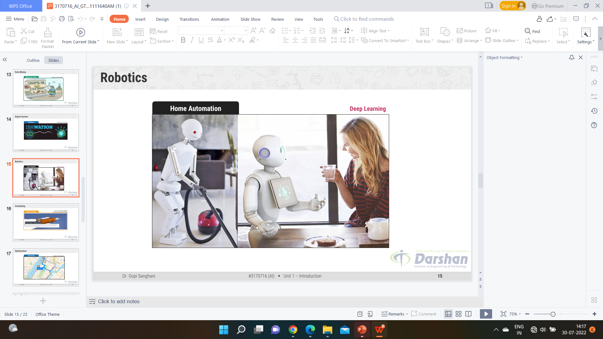
Home Automation

Slide 56

Scheduling

Slide 57
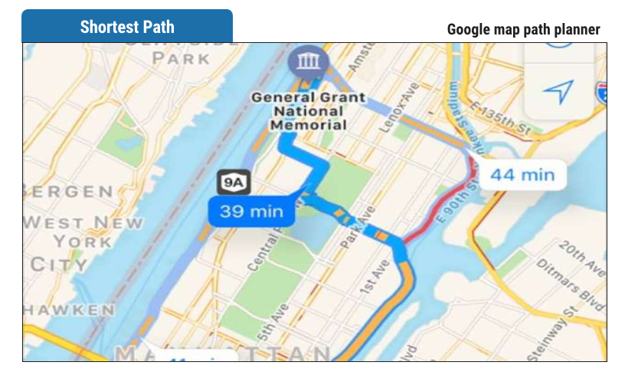
Optimization

Slide 58
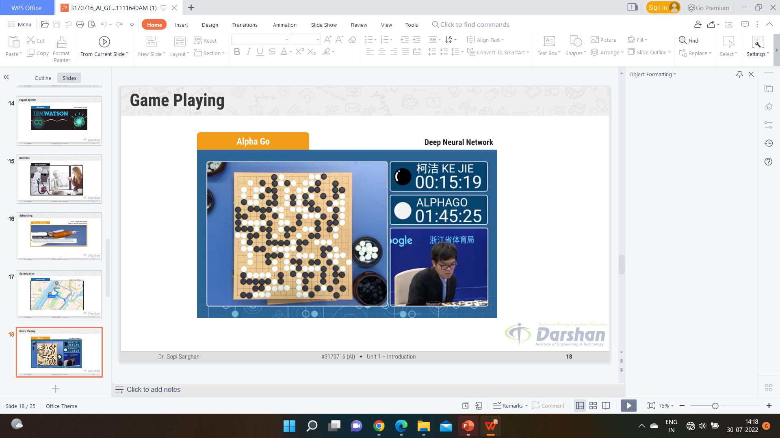
Game Playing

Slide 59
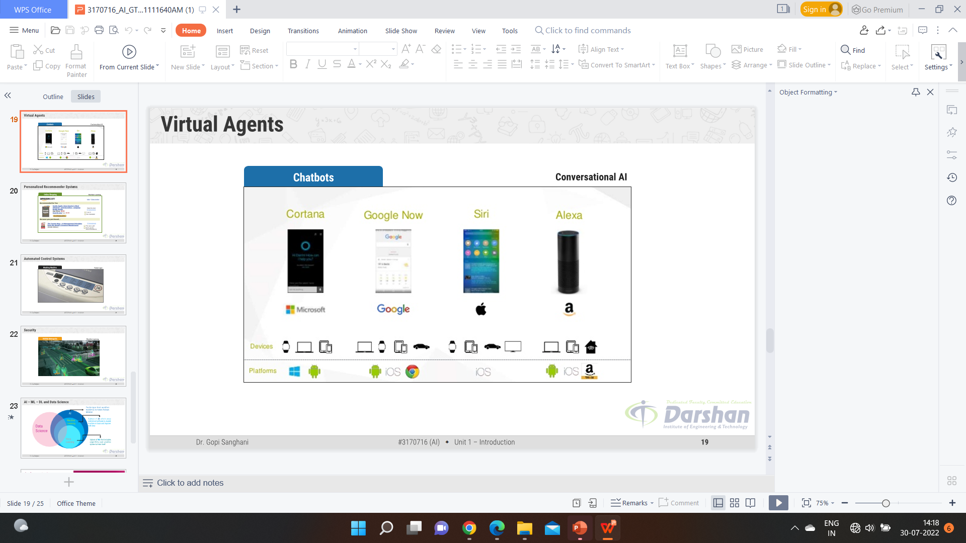
Virtual Assistant

Slide 60

Personalized Recommender System

Slide 61

Automated Control System

Slide 62
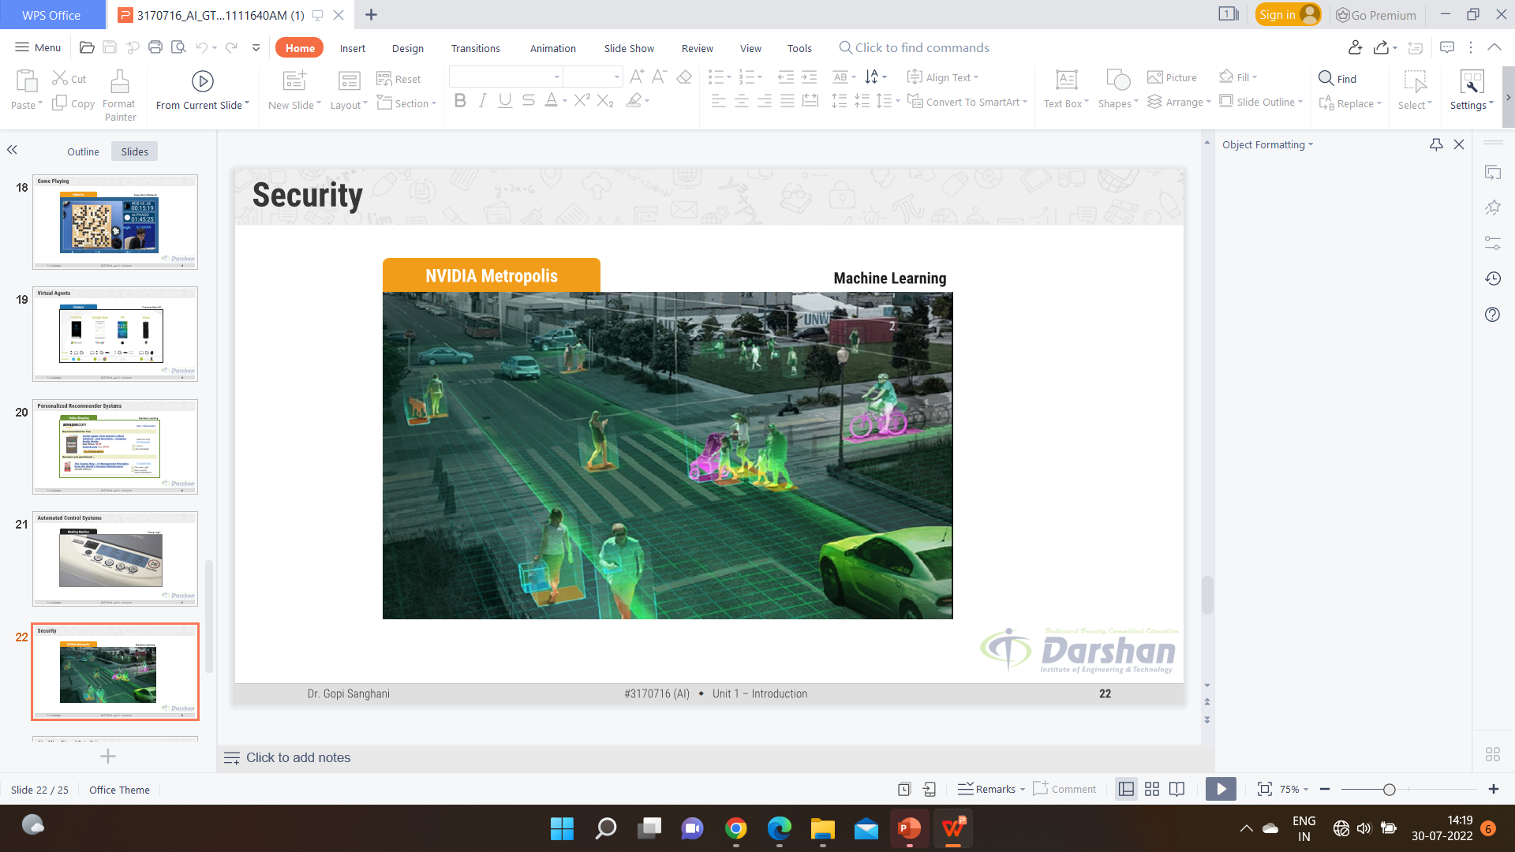
Security

Slide 63
Reference Book
Artificial Intelligence – Kevin Knight and Elaine Rich

Slide 64


